Slide 1

Artificial Intelligence For NLP Lesson-03
人工智能与自然语言处理课程组
2020.01. 20

Slide 2
Outline
Machine Learning
Background
Main Methodologies
Current Trends
Underfitting and Overfitting
Bias and Variance
Model Capacity
Underfitting and Overfitting
Train set, test set, validation set
Influence of dataset
The relation of train, test and validation.

Slide 3
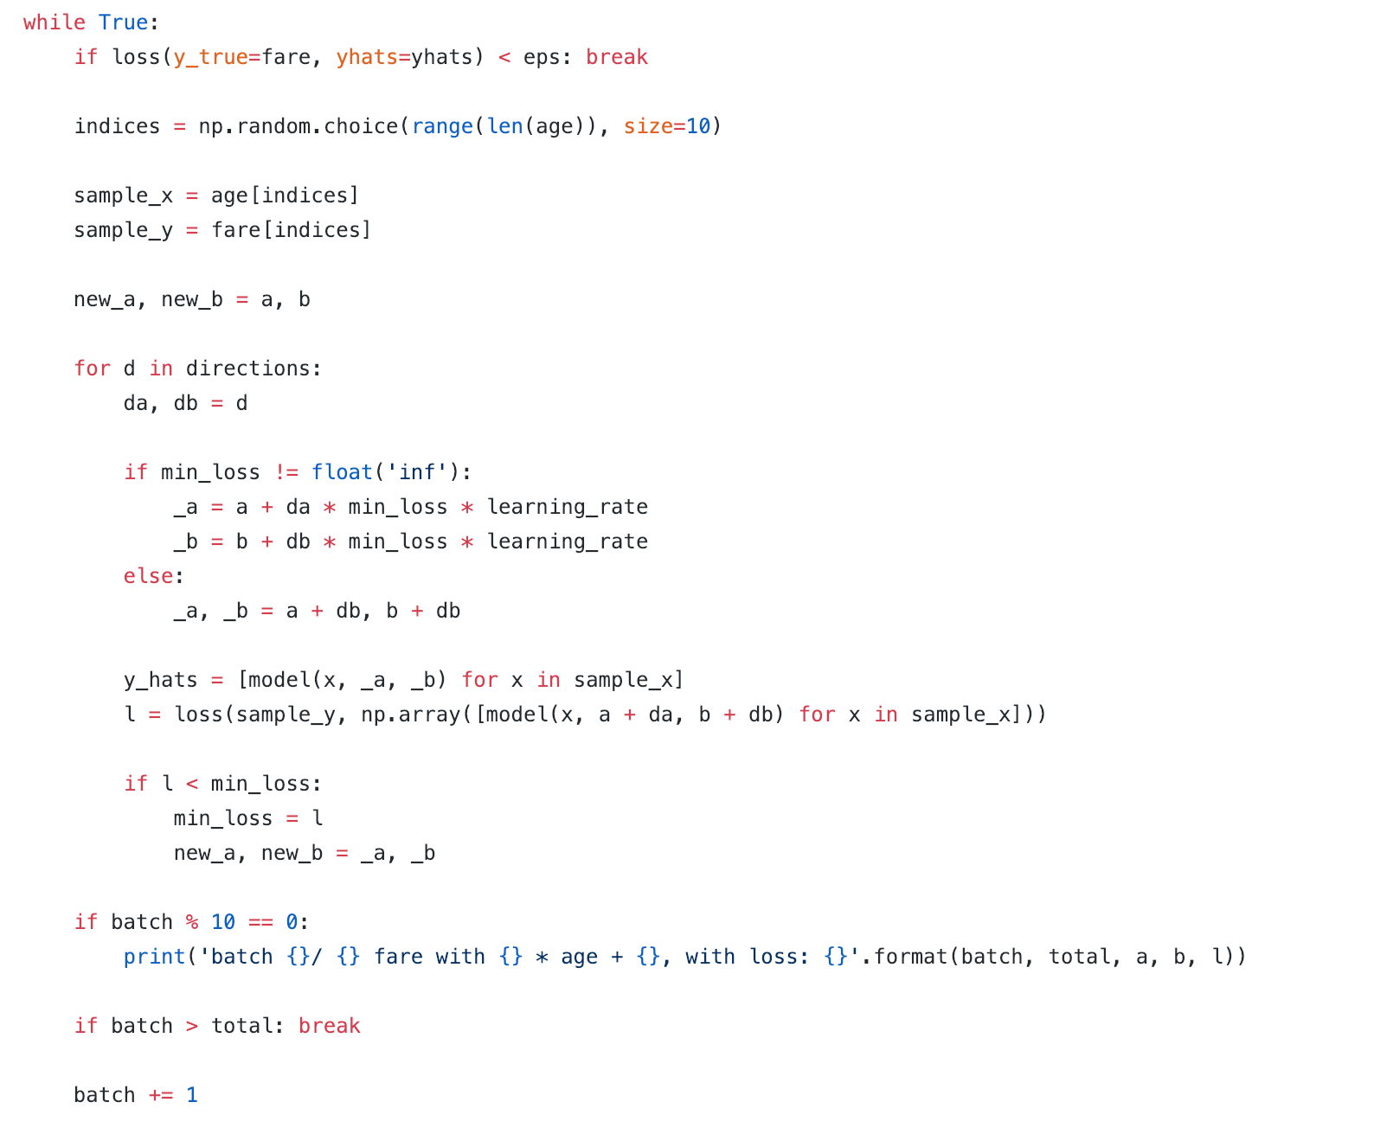
Review

Slide 4
In 1990s, How could we classify spam email?

Slide 5
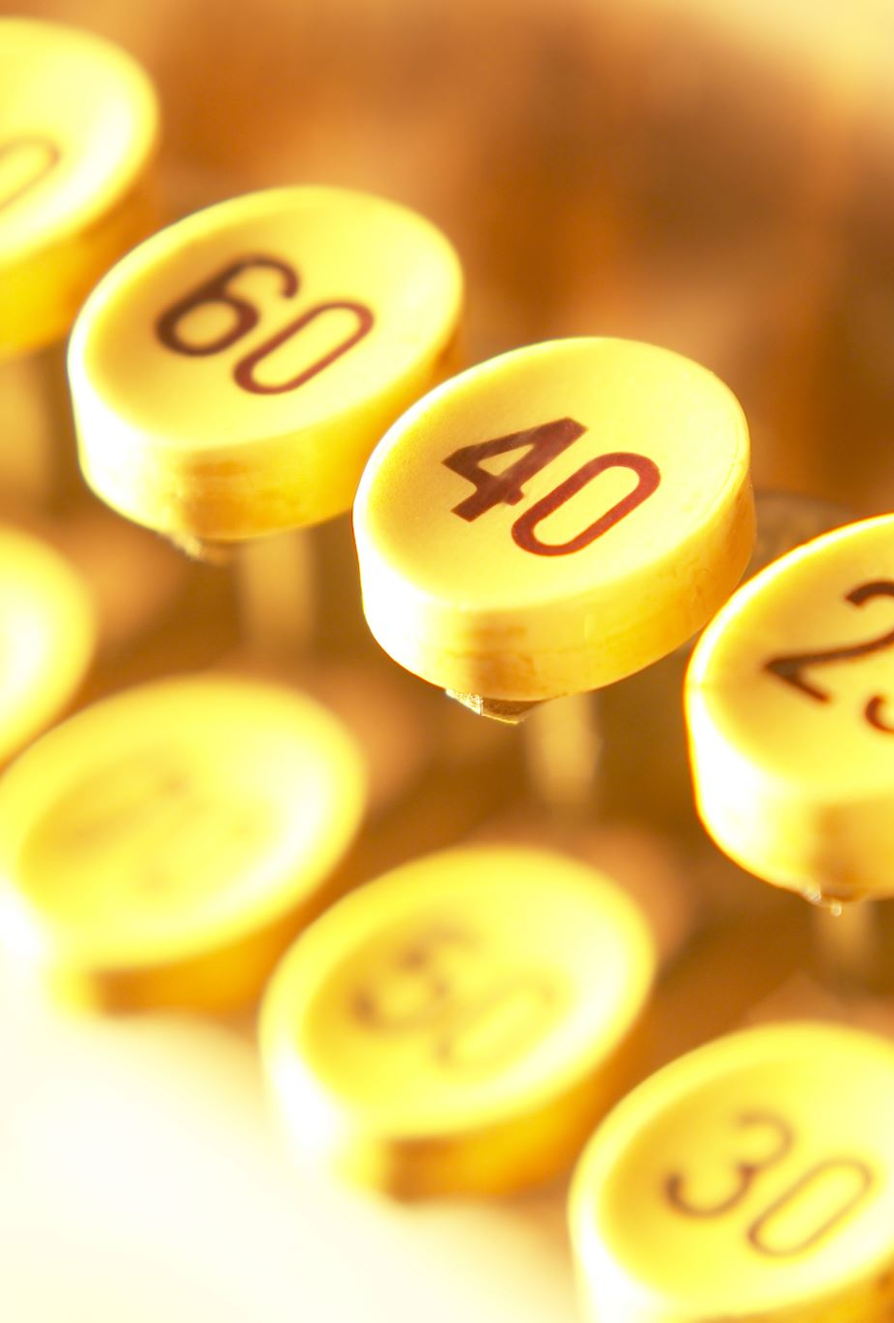
A simple example
Email:
快来，年终最大的优惠来啦！
快回家！看到速回
需不需要尝试一下我们最新的按摩椅，注册成为会员享受更多优惠？
现在开通会员，只需要每月1块钱！
Question:
--> XXXXXXXXX
--> 年终回家，会员更多优惠！

Slide 6
Bayes Implementation

Slide 7
Decision
1. Looking for a book
if there is holding a ceremony
how may days
female vs male
The closet college
..
2. Target: Which college should I go to?

Slide 8
Decision
1. Looking for a book
if there is holding a ceremony
how may days
female vs male
The closet college
..
2. Target: Which college should I go to?
Features
Model
y

Slide 9
Machine Learning Paradigms
-> Based on Probability
-> Based on Linear Algebra
-> Based on Information Entropy
….

Slide 10
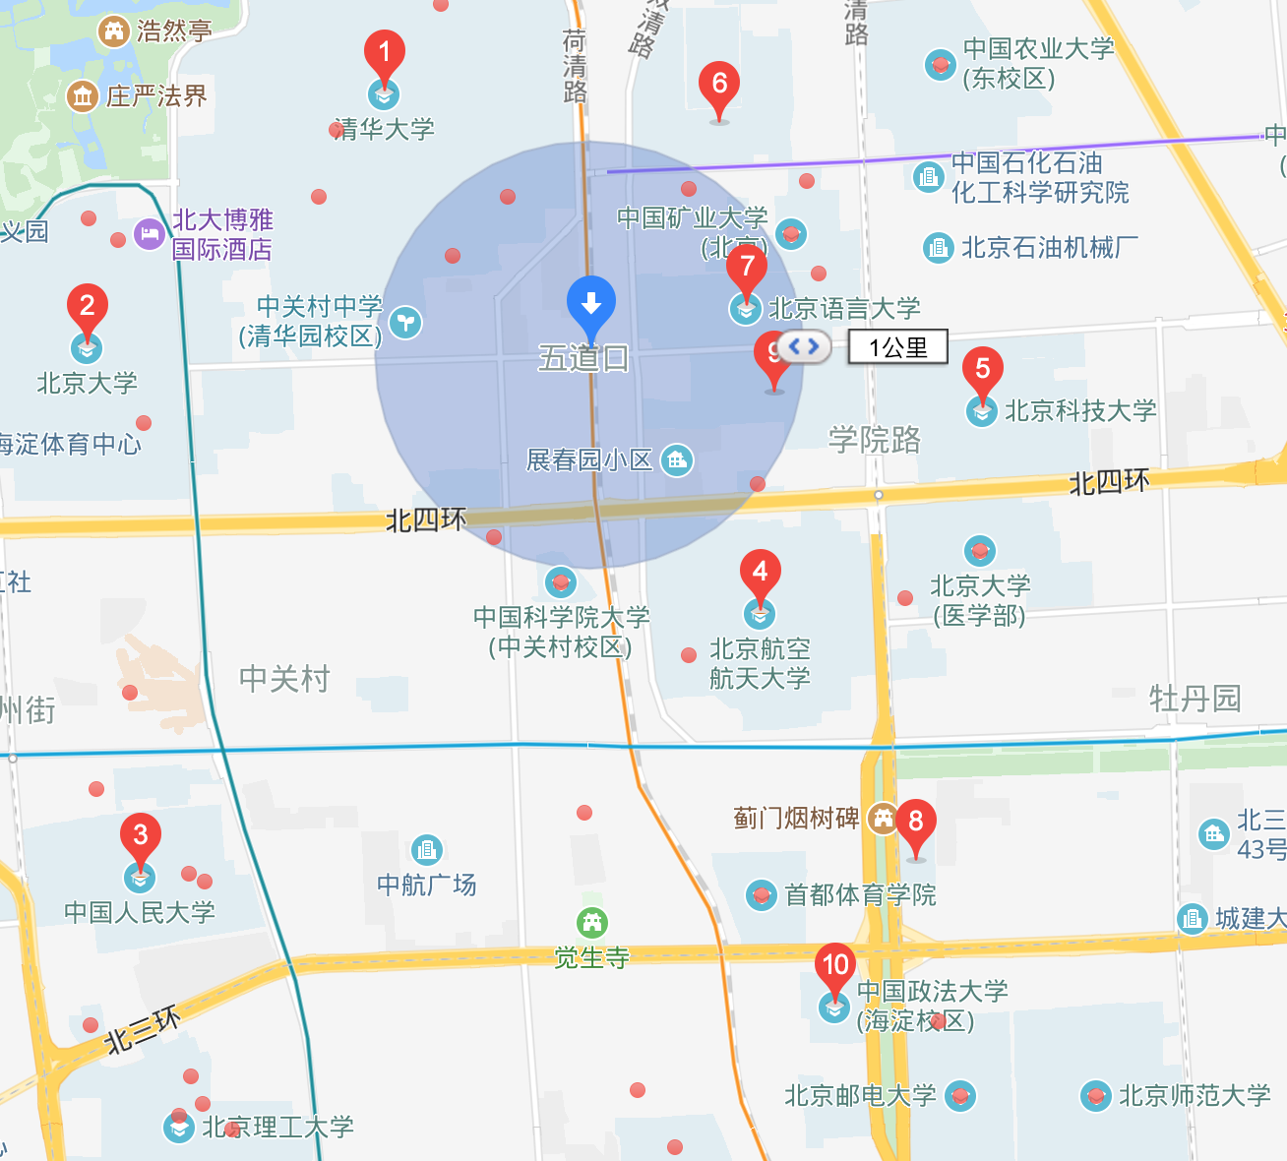
Example Driven

Slide 11
Target
More sales, More money.

Slide 12
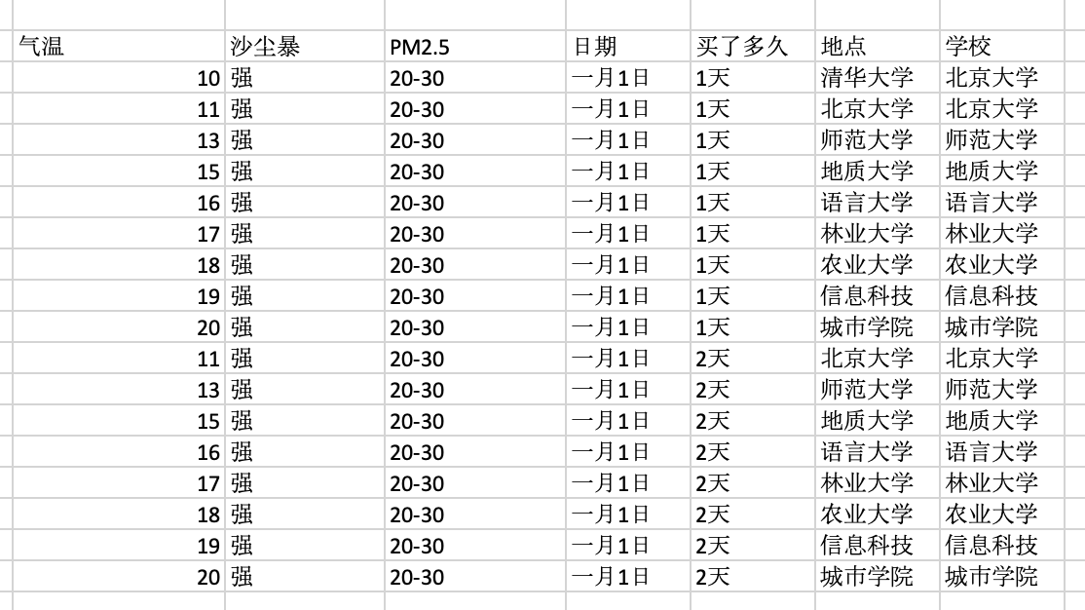
The First Book
Advantage?
Disadvantage?

Slide 13
The First Book
Advantage?
Quick Inference
Easy Computing
….
Disadvantage?
Heavy
…
K-nearest neighbors

Slide 14
How could we achieve k-nearest algorithm?

Slide 15
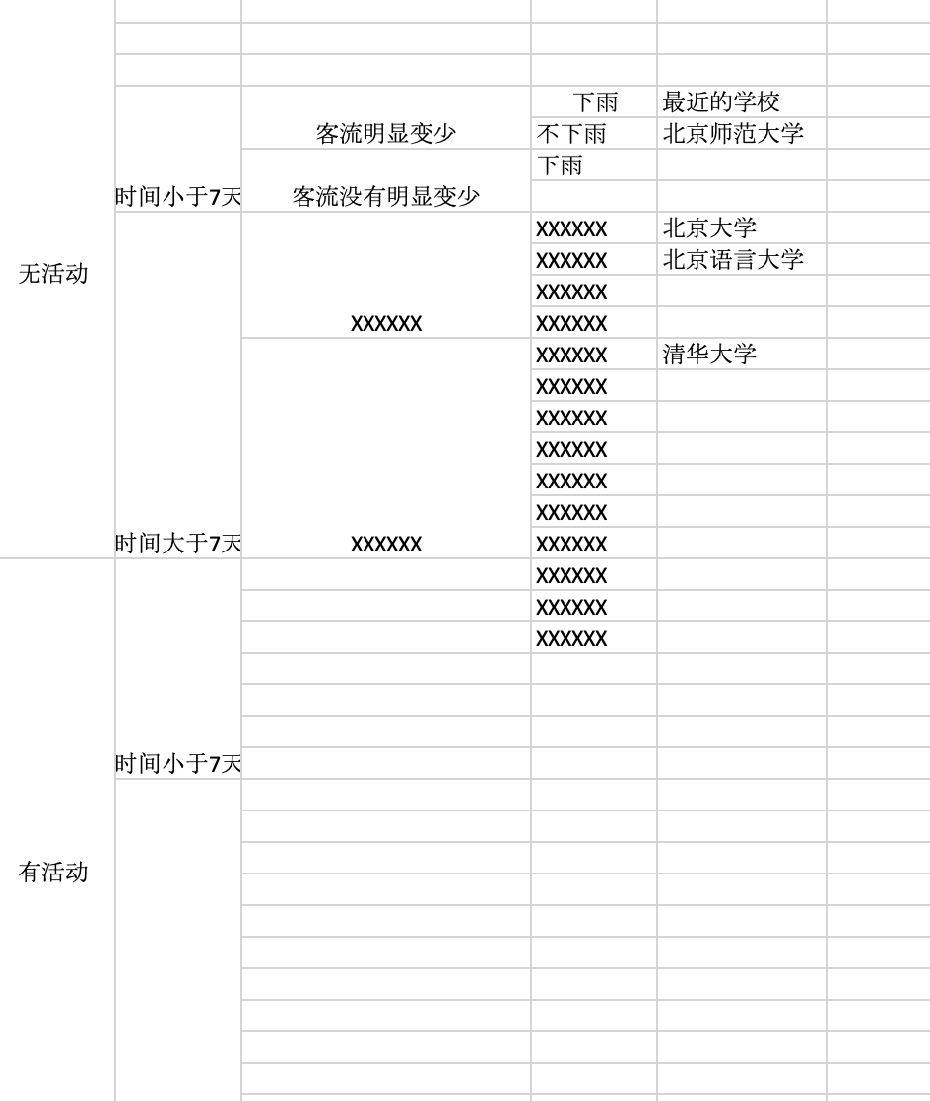
The second book

Slide 16
The second book
Decision Tree

Slide 17
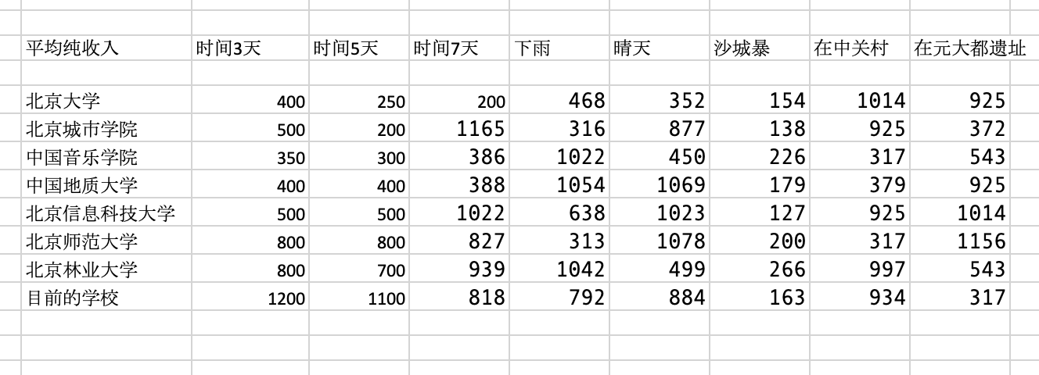
The third book

Slide 18
The third book
P（U|A1, A2, A3）
~ P(A1|U) * P(A2|U) * P(A3|U)
Naïve Bayesian Classification

Slide 19
The Forth book
食堂打饭 不标价钱， 问， 每种菜多少钱?
第一次 茄子*2 + ⻄⽠*1 + 馒头 * 1 : 7.8元
第二次 茄子*1 + ⻄⽠*1 + 馒头 * 2 : 6.5元
第三次 ⽟⽶*1 + 菠菜*2 + 馒头 * 1: 5.6元
...
每种价格?
Neural Network

Slide 20
Chat
Determine if is a valuable customer in Wechat?
What Features do we need?
How to predicate it?

Slide 21

Two Type
1. Classification
2. Regression

Slide 22

Cluster

Slide 23
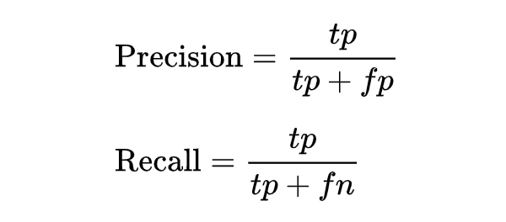
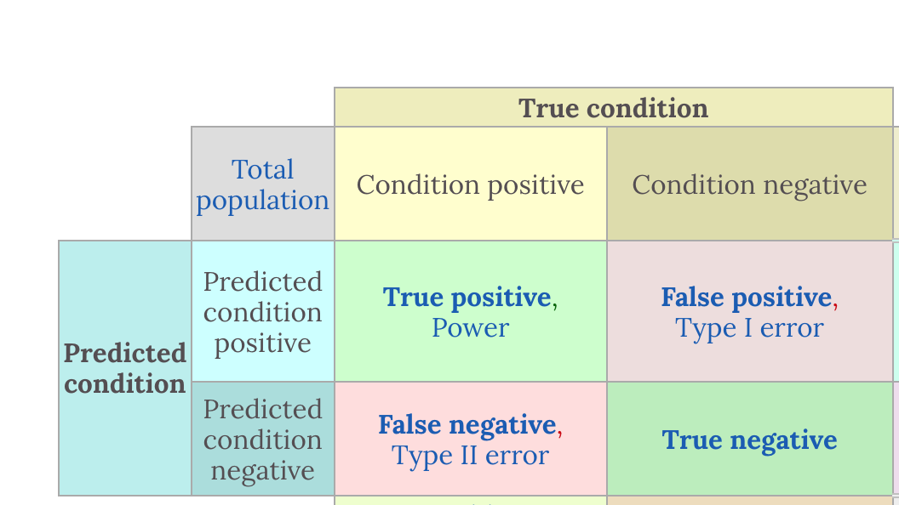
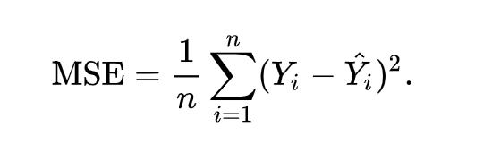
How to evaluate?
Accuracy
Precision
Recall
AOC/AUC
F1_score, F2_score
MSE
Loss Function
Generation
F1 = 2 * (precision * recall) / (precision + recall)

Slide 24
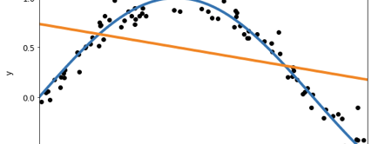
Overfitting & Underfitting
Why?

Slide 25
Lazy-Learning and Eager Learning
Lazy Learning: Target function will be approximately locally;
Dataset with few attributes.

Slide 26
Outliner
What’s outliner and how to detect?
Percentile

Slide 27
Bias and Variance
dilemma
The bias is an error from erroneous assumptions in the learning algorithm. High bias can cause an algorithm to miss the relevant relations between feature and target outputs. (underfitting);
The variance is an error from sensitivity to small fluctuations in the training set. High variance can cause an algorithm to model the random noise in the training data, rather than the intended outputs (overfitting).

Slide 28
Train, validation, test
Good Memory V.S Good Learning

Slide 29
Train, validation, test
Good Memory V.S Good Learning

Slide 30
From supervised learning to unsupervised learning

Slide 31

Next Deep insight on Deep learning
In next course, we will implement a deep learning framework using pure python from scratch
If you want to learn something, the best way is to create it from start.
In course 9 and course 10, we will give us more and advanced information of these “tradidional

Slide 32
Assignment
作业在我们的Jupyter Notebook中
1. Summarize the reasons of overfitting and underfitting. Put them in github repository.
2. Implement the absolute value loss function in Linear Regression Model;
3. and other coding practice and QA problems.

